Slide 1
Mining microbial dark matter in ruminants
Mick Watson, The Roslin Institute, University of Edinburgh

Slide 2
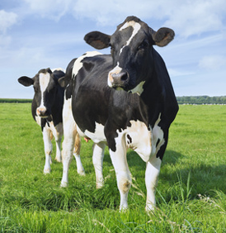
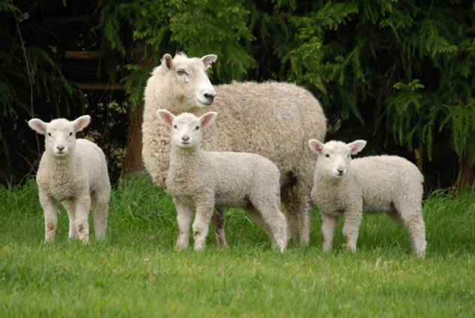
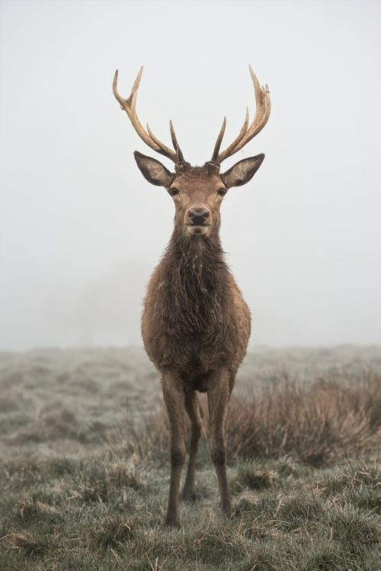
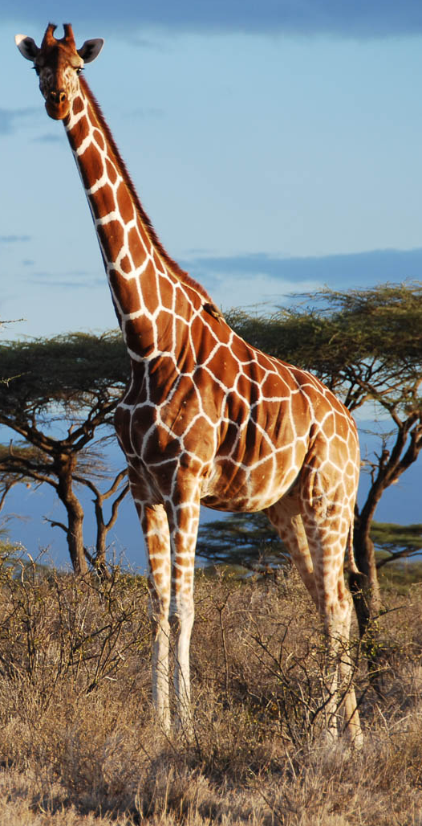
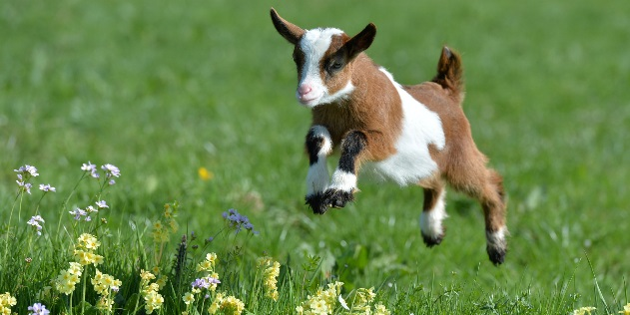

What are ruminants?
Key fact: the ability to acquire nutrition from plant-based diet via a special stomach (the rumen), primarily by microbiome

Slide 3

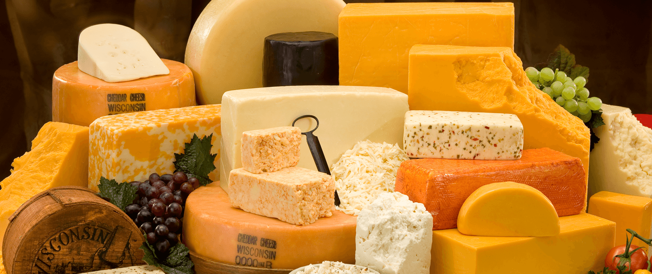
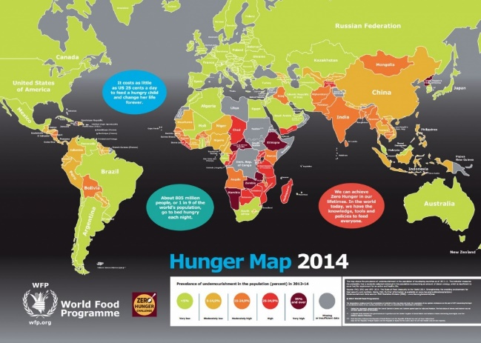
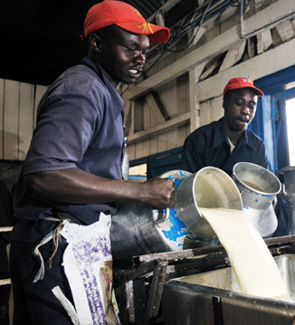
Why do you care about them?
Food!!
There are 270million dairy cows in the world
They produce 770 billion litres of milk annually
This has a value of $328billion
There are around 570 million farms in the world
Over 1 in 4 are involved in milk production – 150 million farms
Milk is the fifth largest provider of energy and the third large provider of protein and fat for humans
Milk and dairy animals provide a key route out of poverty in lower and middle income countries
However…
Dairy cattle in the USA will produce around 9 times more milk than dairy cattle in e.g. India
Diet, genetics, health, environment

Slide 4
Why do we care about them?
Energy from food
"Our results indicate that the obese microbiome has an increased capacity to harvest energy from the diet. Furthermore, this trait is transmissible: colonization of germ-free mice with an 'obese microbiota' results in a significantly greater increase in total body fat than colonization with a 'lean microbiota'"
Turnbaugh et al (2006) An obesity-associated gut microbiome with increased capacity for energy harvest. Nature 444(7122):1027-31
Novel enzyme discovery
"An initial assembly of the metagenomic sequence resulted in 179,092 scaffolds... Only 47 (0.03%) of the assembled scaffolds showed high levels of similarity to previously sequenced genomes available in GenBank. These results suggest that the vast majority of the assembled scaffolds represent segments of hitherto uncharacterized microbial genomes.
Hess M et al (2011) Metagenomic discovery of biomass-degrading genes and genomes from cow rumen. Science. 331(6016):463-7.
Methane Emissions
Globally, ruminant livestock produce about 80 million metric tons of methane annually, accounting for about 28% of global methane emissions from human-related activities.

Slide 5
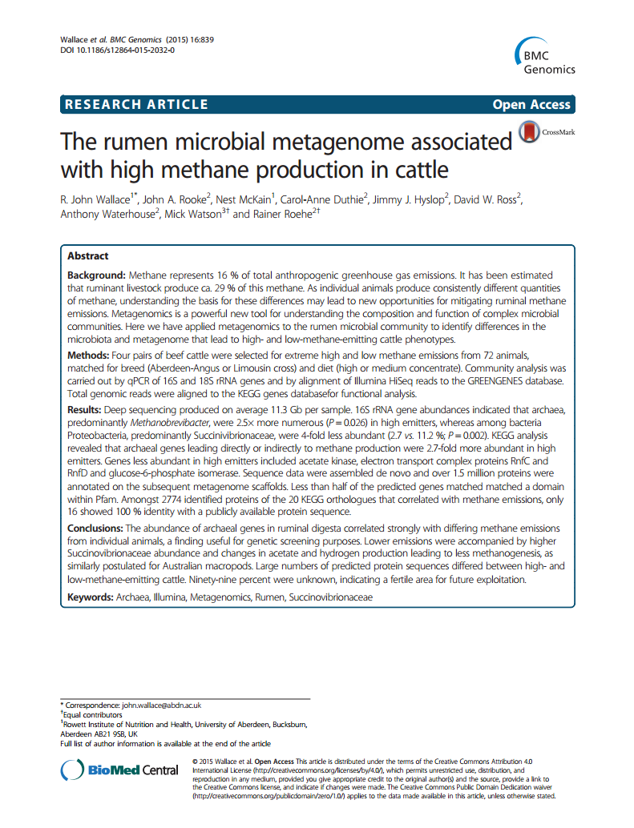
The rumen microbiome
Methane
Methane is an awful greenhouse gas with a global warming potential 25 times that of CO2
Ruminants are the major producers of methane emissions from anthropogenic activities
Our studies show high methane production is highly correlated with (1) abundance of archaea; and (2) abundance of enzymes in methane pathway
Novelty
Eight samples -> 1.5 million protein predictions
Less than half have a known protein domain
From 6000 representatives of 44 enzyme classes associated with methane production
Only 29 in NR
At 90% identity only 800 have a hit

Slide 6
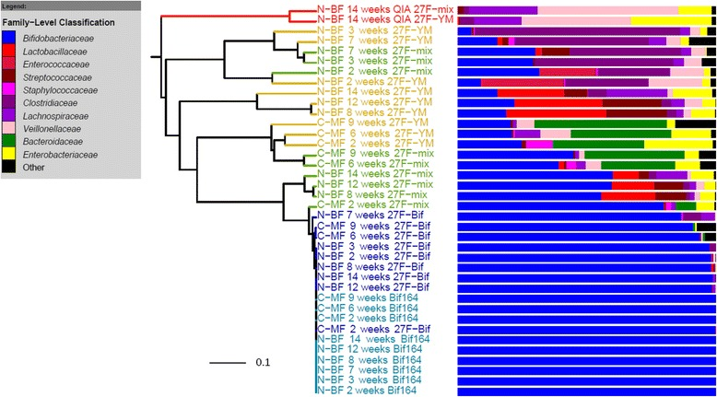
Extraction method is key
TL;DR
Non-bead-bashing techniques risk losing major clades from the microbiome
Key fact: grinding up your cells with tiny sharp glass beads also grinds up your DNA
We bead bash because we want the most complete picture
Walker AW, Martin JC, Scott P, Parkhill J, Flint HJ, Scott KP. 16S rRNA gene-based profiling of the human infant gut microbiota is strongly influenced by sample processing and PCR primer choice. Microbiome. 2015 Jun 22;3:26. doi: 10.1186/s40168-015-0087-4.
No bead bashing
Standard primers
Primers with degenerate bases
Bifidobacteria specific

Slide 7
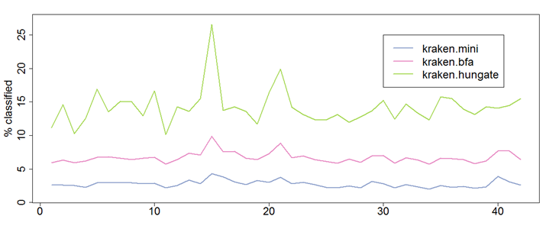
The rumen microbiome as an unexplored environment
Attempts to classify 42 cattle microbiome samples
Using Kraken with 3 databases
Mini (default)
BFA (every bacterial, fungal and archaeal genome I could get my hands on)
Hungate (as BFA but with additional Hungate 1000 genomes)
Percent classified rarely above 15%

Slide 8
Hypothesis:
there are many bacterial and archael genomes in the rumen microbiome that we simply haven’t sequenced yet
Enter MinION

Slide 9
Three MinION runs from a single sample
Product | Version
Device | MinION MK1b
Flow cell | MinION FLO-MIN106
Kits | Ligation Sequencing Kit 1D
Data analysis | poRe Canu Nanopolish BWA blobtools Prokka BLAST+ Bandage R
Stats
Product | Version
Device | MinION MK1b
Flow cell | MinION FLO-MIN106
Kits | Ligation Sequencing Kit 1D
Data analysis | poRe Canu Nanopolish BWA blobtools Prokka BLAST+ Bandage R
Stats
Product | Version
Device | MinION MK1b
Flow cell | MinION FLO-MIN106
Kits | Ligation Sequencing Kit 1D
Data analysis | poRe Canu Nanopolish BWA blobtools Prokka BLAST+ Bandage R
Stats
Reads | 836864
Max | 411455
Total | 4.8Gb
Mean | 5737
Median | 3275
N50 | 11453
Reads | 890172
Max | 1397153
Total | 4.8Gb
Mean | 5393
Median | 3334
N50 | 10214
Reads | 566602
Max | 1695890
Total | 3.1Gb
Mean | 5424
Median | 3017
N50 | 10697

Slide 10
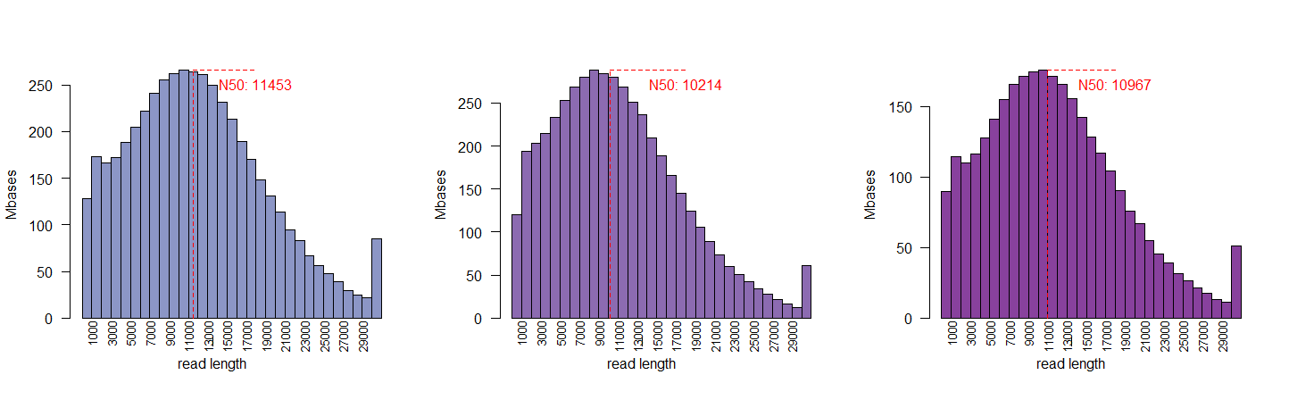
Read lengths

Slide 11

Assemblies
Stats
Length 100Mb
Contigs 1156
Average 96Kb
N50 184kb
Several predicted circular contigs

Slide 12
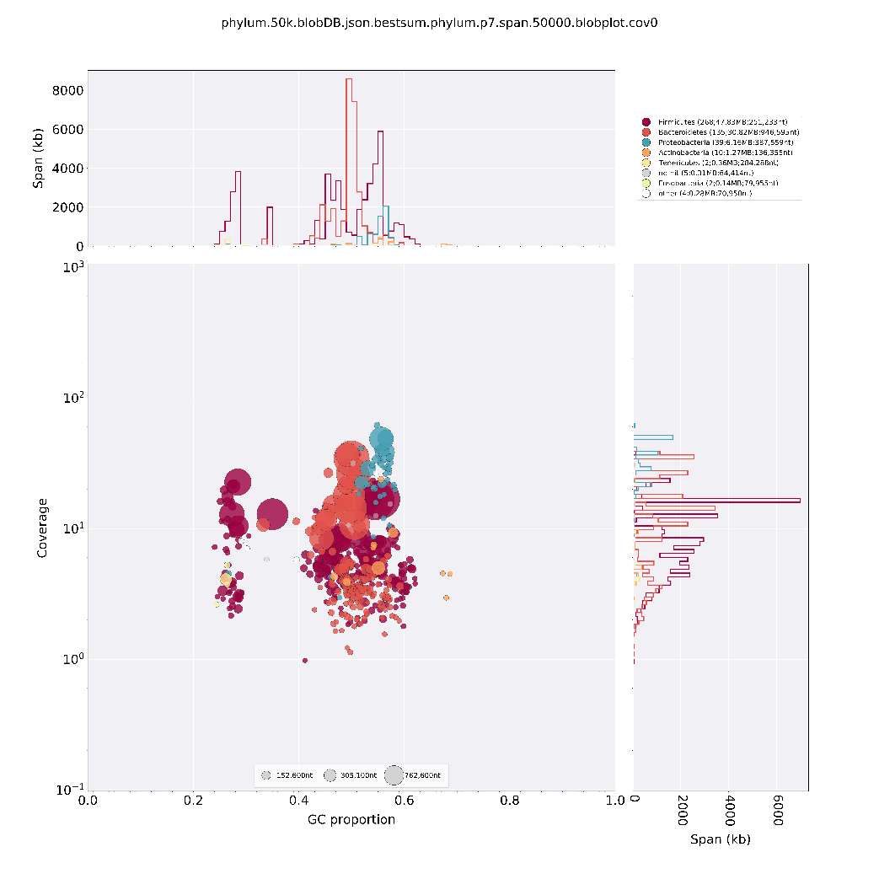
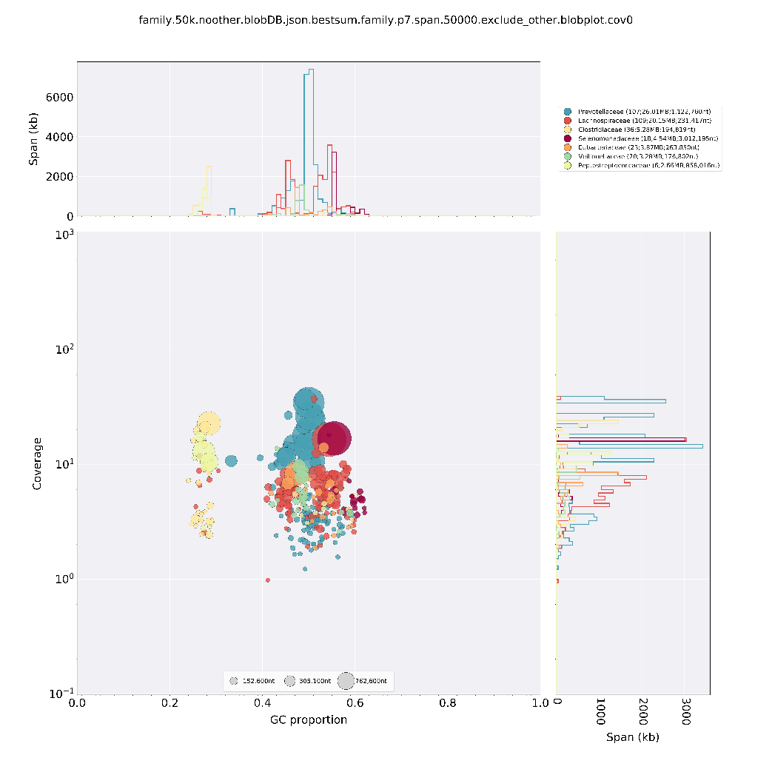
Blobtools can give us a picture
Phylum
Genus

Slide 13
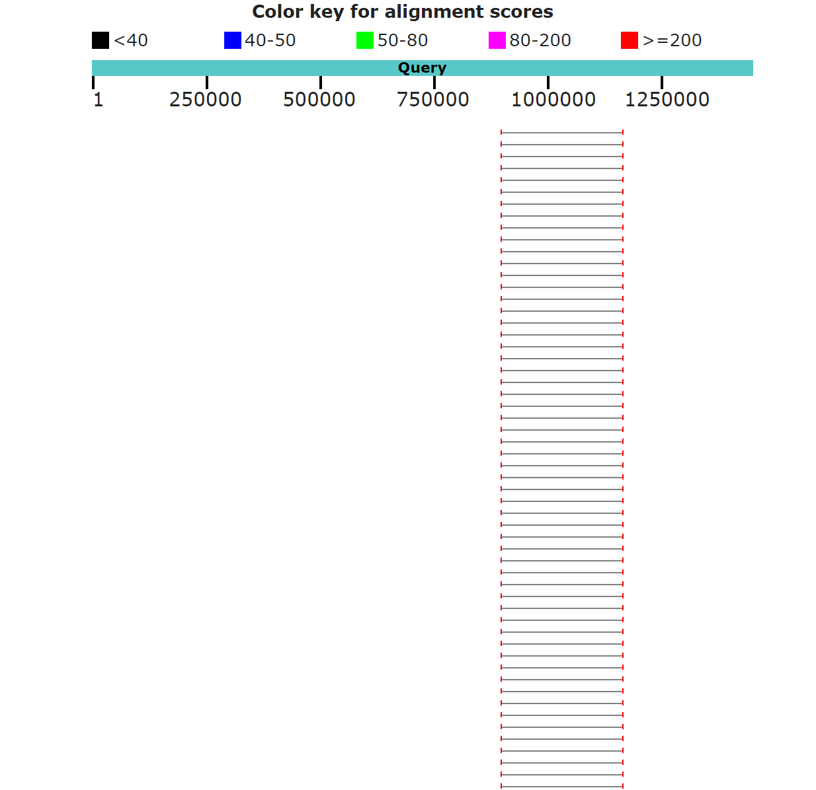
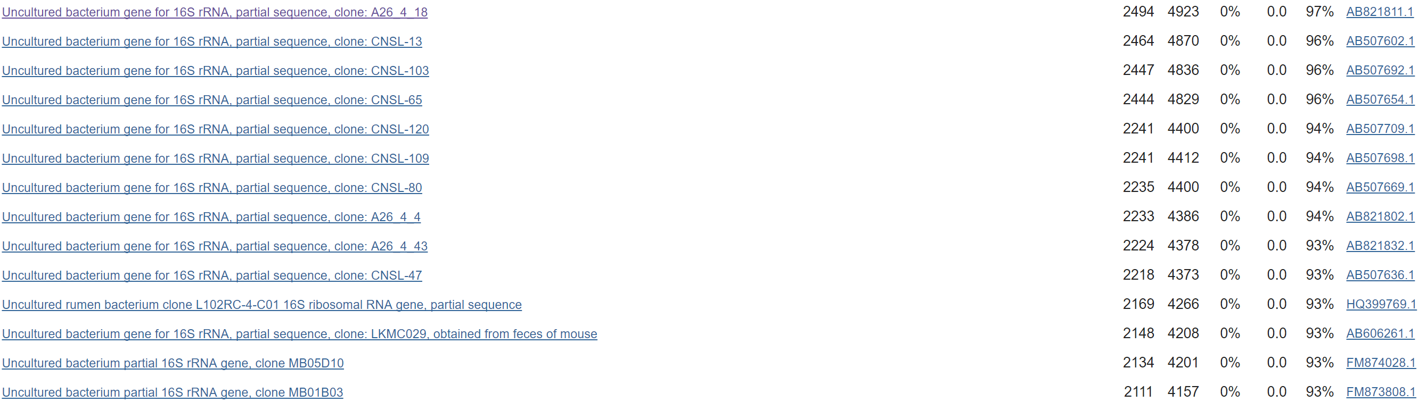
…but not the whole picture..

Slide 14

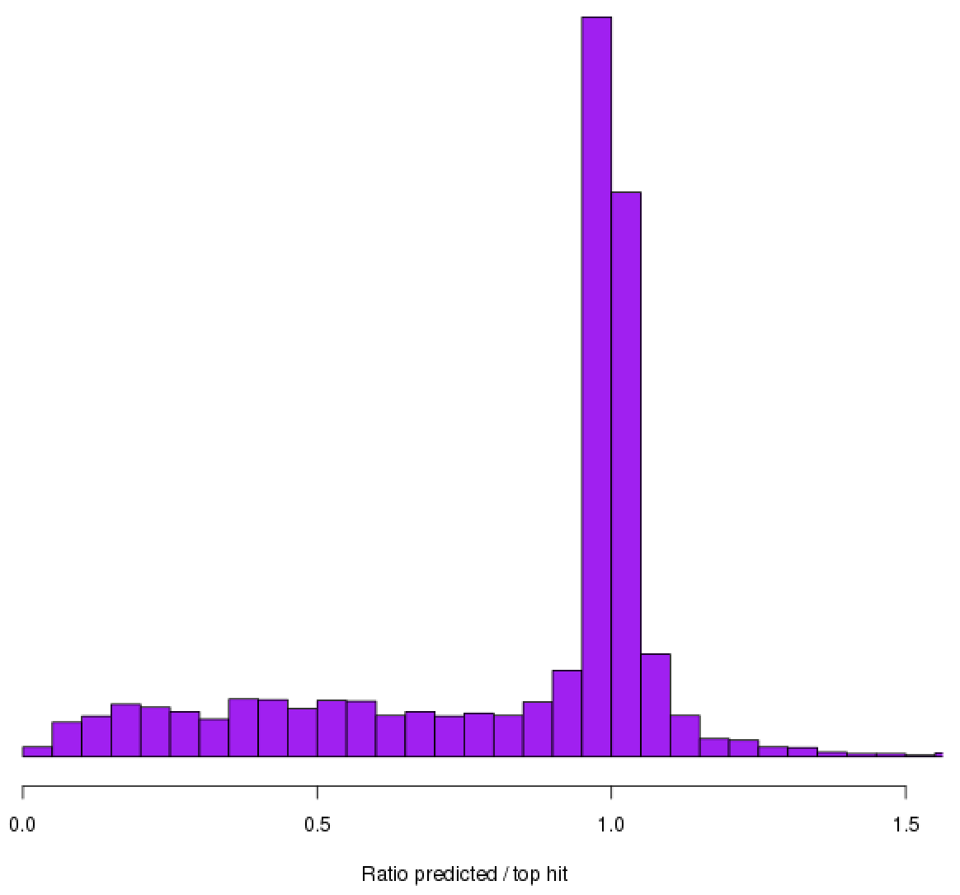
Others we know more about….
Details
3,223 proteins
1276 top hit is to Selenomonas ruminantium
16S sequences have 95%
Protein ratio around 1 – good! But with long tail….
Probable new Selenomonas species

Slide 15
Summary
Ruminants are important
Their microbiomes contain genomes not sequenced before
Even with bead bashing, we can get long reads
We can assemble complete or near-complete genomes
Can polish out most of the errors
Even most abundant genomes look like new species
Even bioinformaticians can run the MinION

Slide 16



Funders: BBSRC, Roslin Foundation, TSB
People: Amanda Warr, Rob Stewart, Jackie Evans, Deppie Roumpekka, Trong Wisedchanwet, Marc Auffret, John Wallace, Rainer Roehe, industry partners
Edinburgh Genomics: http://genomics.ed.ac.uk
The Roslin Institute: http://www.roslin.ed.ac.uk

